Slide 1
Querying SQL
Databases 101

Slide 2


What’s Not a Database
Flat files
Including comma-separated files (.csv)
Or json
Or xml
Excel, Google Sheets - most popular BI tools in the world
There are dangers of "silo'ing" data in a business
Though, valuable tools for self-service business intelligence
But not a database!

Slide 3
What is a Database
Real enterprise scale database platforms: Microsoft SQL Server Azure SQL DB (what we’re using today!) Oracle MySQL IBM DB2

Slide 4
Document-based databases
Other types of databases use Documents to store data.
“NoSQL” databases store structured .json documents instead of rows and columns
For example, Azure CosmosDB, MongoDB, PostgreSQ, SAP HANA
They have different uses for different types of systems

Slide 5

MS Access is a “Database Simulator”
Great for students! But…
Microsoft Access documentation is full of caveats about the lack of concurrency and scalability for Access. Don’t use for real work!
The 32-bit "Microsoft Jet [the database engine inside Access] can only handle a limited number of sessions."
"...when multiple concurrent users make requests of a Access database, unpredictable results may occur."
"...it was not intended (or architected) for high-stress performance..."

Slide 6
SQL
“Structured Query Language”
Pronounced “sequel” not “Ess Que Ell”
“SQL Server” is the name specifically for the Microsoft database platform

Slide 7
Some Terminology
Normalized, Relational (RDBMS), Normal Form, OLTP Many tables contain structured data with rules for integrity Good for writes, transactions, distinct lists for dropdowns
De-normalized, Flattened, Flat File Just one table contains all the data in very wide rows Good for simple reporting, extracts to heterogenous systems
Dimensional, Data Cube, Star Schema, OLAP Many tables contain data formatted for massive reads Good for complex reporting, pre-calculated aggregation

Slide 8
Some Terminology
Databases, which contain
Tables, which contain
Columns and Rows, which contain data in cells or fields.

Slide 9
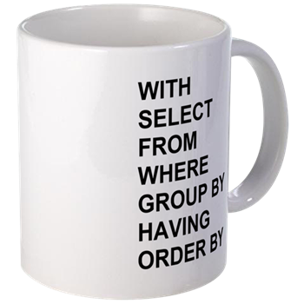
Basics of SQL
WITH
SELECT
FROM
WHERE
GROUP BY
HAVING
ORDER BY;

Slide 10
Basics of SQL
WITH
SELECT – what column(s)
FROM – from what table(s)
WHERE – with what filter(s)
GROUP BY
HAVING
ORDER BY – in what order;

Slide 11
Basics of SQL
WITH – use a CTE
SELECT – what column(s)
FROM – from what table(s)
WHERE – with what filter(s)
GROUP BY – aggregate by these
HAVING – filter the aggregates
ORDER BY – in what order;

Slide 12
Queries on Flat Data

Slide 13
SQL Examples
Toolbox: lab - TSQL 101.sql Link: https://github.com/williamadba/Public-Presentations
This syntax in these samples is simple enough that it should work with no/minimal alteration in any ANSI SQL-compliant database platform.

Slide 14
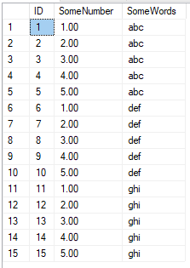
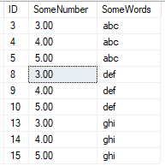
Basics of SQL
--Not best practice
--Use Schema.objectname
--Semicolon please!
Better:
SELECT ID, SomeNumber, SomeWords
FROM dbo.SomeTable
WHERE SomeNumber > 2;
Let’s say I only want all columns from this table, but only the rows where
SomeNumber > 2
Works:
SELECT *
FROM SomeTable
WHERE SomeNumber > 2

Slide 15
Comments
Yes, you should comment your code.
--comment the rest of this line
/*
Comment a whole block of text
*/

Slide 16
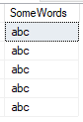
Basics of SQL
I only want SomeWords that begin with ‘a’
Works:
SELECT SomeWords
FROM dbo.SomeTable
WHERE SomeWords like 'a%'
Also works:
SELECT SomeWords
FROM dbo.SomeTable
WHERE LEFT(SomeWords, 1) = 'a'
Lots of different string manipulation functions:
https://docs.microsoft.com/en-us/sql/t-sql/functions/string-functions-transact-sql

Slide 17
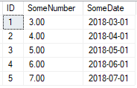
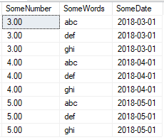
Basics of SQL
I have another table with SomeNumber.
But second table has important dates. I need to join the two tables on SomeNumber, and display data only where I find a match.
Works:
SELECT SomeTable.SomeNumber, SomeWords, SomeDate
FROM dbo.SomeTable INNER JOIN dbo.SomeTable2
ON SomeTable.SomeNumber = SomeTable2.SomeNumber
ORDER BY SomeTable.SomeNumber;
SELECT SomeTable.SomeNumber, SomeWords, SomeDate
FROM dbo.SomeTable --No table aliases INNER JOIN dbo.SomeTable2
ON SomeTable.SomeNumber = SomeTable2.SomeNumber
ORDER BY SomeTable.SomeNumber;
--No table aliases
Better:
SELECT t1.SomeNumber, t1.SomeWords, t2.SomeDate
FROM dbo.SomeTable AS t1
INNER JOIN dbo.SomeTable2 AS t2
ON t1.SomeNumber = t2.SomeNumber
ORDER BY t1.SomeNumber, t1.SomeWords, t2.SomeDate;

Slide 18

Joins
Source: https://www.codeproject.com/Articles/33052/Visual-Representation-of-SQL-Joins

Slide 19
Let’s talk about Keys
Primary Key
Identify parent relationships to other tables
Unique Key
Identify uniqueness(es), can have more than one
Foreign Key
Identify this column as a child to another table
Natural Key
Business-generated key
Surrogate Key
System-generated key

Slide 20
Keys
Primary Key
Identify parent relationships to other tables
Unique Key
Identify uniqueness(es), can have more than one
Foreign Key
Identify this column as a child to another table
Natural Key
Business-generated key
Surrogate Key
System-generated key
Often these keys are on the same column, when we create an IDENTITY (autoincrement) column.
Also commonly serves as the Key to clustered index.

Slide 21
Keys
Primary Key
Identify parent relationships to other tables
Unique Key
Identify uniqueness(es), can have more than one
Foreign Key
Identify this column as a child to another table
Natural Key
Business-generated key
Surrogate Key
System-generated key
These two keys MUST NOT be the same!
Users should never see Surrogate Keys, and Surrogate Keys should never change.
Users should only see Natural keys, and can therefore change these values.

Slide 22
Keys
Primary Key
Identify parent relationships to other tables
Unique Key
Identify uniqueness(es), can have more than one
Foreign Key
Identify this column as a child to another table
Natural Key
Business-generated key
Surrogate Key
System-generated key
Primary Keys are always unique, but you can also have more than one Unique Key. You can have a Primary Key on an IDENTITY field, and also enforce uniqueness on one or more other columns.

Slide 23
Keys
Primary Key
Identify parent relationships to other tables
Unique Key
Identify uniqueness(es), can have more than one
Foreign Key
Identify this column as a child to another table
Natural Key
Business-generated key
Surrogate Key
System-generated key
Foreign Keys reference the Primary Key of another table.

Slide 24
Keys
Primary Key
Identify parent relationships to other tables
Unique Key
Identify uniqueness(es), can have more than one
Foreign Key
Identify this column as a child to another table
Natural Key
Business-generated key
Surrogate Key
System-generated key
Surrogate Keys are the best choice for PK’s, because they can never change, and so they can never cause a cascading update through FK’s.

Slide 25
Normalization Antipatterns
Bad (one table)
Student
NAME(key)_PHONE1_PHONE2_PHONE3_PHONE4…
Good (three tables):
Student
ID(key)_NAME
StudentPhone
ID(key)_StudentID_PhoneNum_PhoneTypeID
PhoneType
ID(key)_TYPE

Slide 26
Normalization Antipatterns
Bad (one table)
Student
NAME(key)_PHONE1_PHONE2_PHONE3_PHONE4…
B Smith 2255555555 2254444444 2253333333 NULL
J Smith 2255555555 2254444444 NULL NULL
K Smith 2255555555 2254444444 2251111111 2259999999
Good (three tables): Student
ID(key)_Name
StudentPhone 1 B Smith
ID(key)_StudentID_PhoneNum_PhoneTypeID 2 J Smith
1 1 2255555555 1 3 K Smith
2 1 2254444444 1
3 1 2253333333 2 PhoneType
4 2 2255555555 1 ID(key)_Type
5 2 2254444444 2 1 Mobile
6 3 2255555555 1 2 Home
7 ….

Slide 27
Queries on Normalized Data

